Slide 1


Characterization of the Pre-Lytic Active Egress of a Non-Enveloped Virus

Slide 2

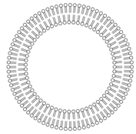
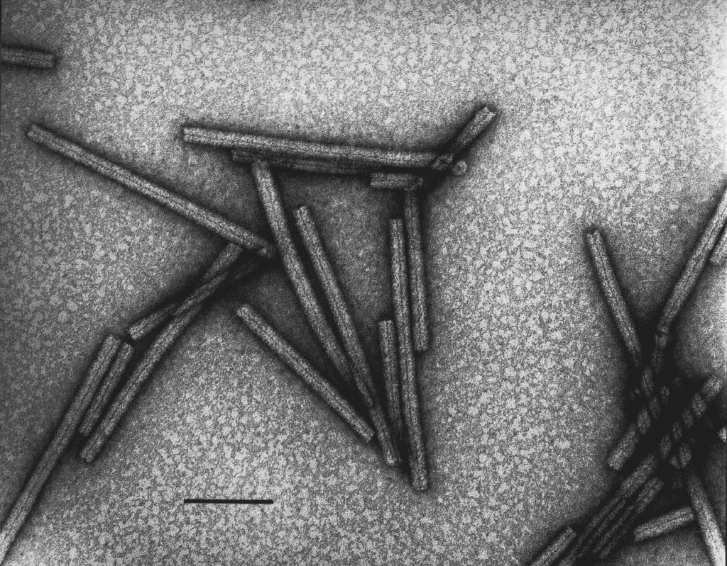
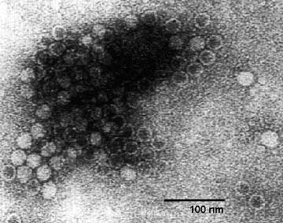
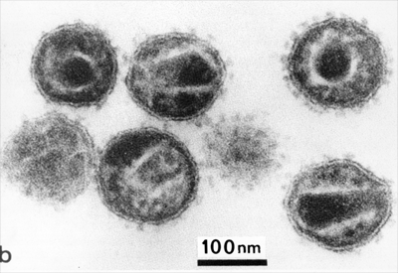

The Nature of Viruses
1/45
Viruses…
Infect all types of life forms (animals, plants and microorganisms).
Appear in every ecosystem on earth.
Consist of two or three parts:
Genetic material made from either DNA or RNA
Protein coat, called the capsid
Envelope of lipids that surrounds the protein coat (Enveloped viruses)
Display a wide diversity of morphologies
Enterobacteria phage T4
(Myoviridae)
Tobacco Mosaic Virus
(Virgaviridae)
Minute Virus of Mice
(Parvoviridae)
Human Immunodeficiency Virus
(Retroviridae)
100 nm
100 nm
Complex with prolate head
Helical
Icosahedral
Enveloped
Notes:
All types of organisms
In every ecosystem on earth
Virus is a set of genes composed of either RNA or DNA
Genome packaged into a protein coat
lipid bilayer membrane external to the coat → called envelope
Vast diversity of morphologies → electron microscopy pictures
helical
icosahedral
enveloped
complex → prolate (icosahedron with elongated 5-fold axis)
Digression to the history..
→TMV first virus which has been crystallized in 1935

Slide 3
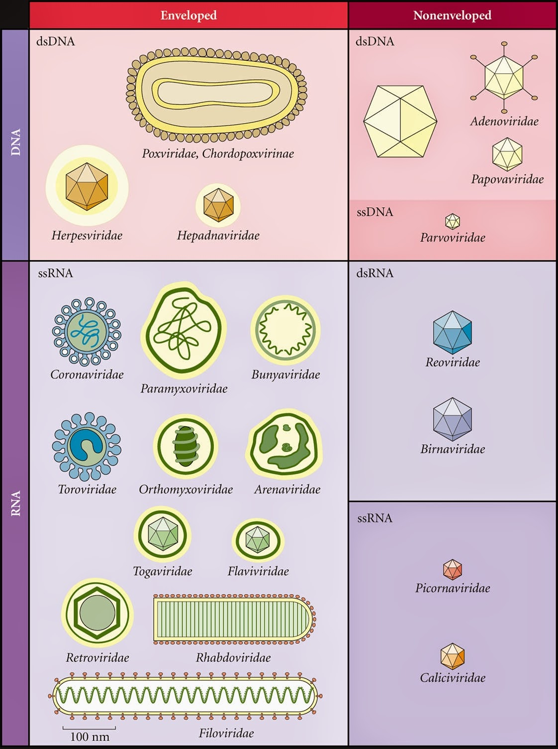

Vast Diversity of Viruses
Enveloped
Non-Enveloped
International Committee on
Taxonomy of Viruses (ICTV)
Phenotypic characteristics
Morphology
Nucleic acid type
Mode of replication
Host organisms
Type of disease
DNA
Baltimore Classification
Mechanism of mRNA production
RNA
Notes:
Organize the vast variety of different viruses → ICTV classification system
Based on phenotypic characteristics
morphology
type of nucleic acids
mode of replication
host range
type of disease it causes
Baltimore classification → simplified classification system
just considering the mechanism of mRNA production
In the table based on the ICTV classification system
Parvoviruses: only viruses in the known biosphere that have both linear and single-stranded DNA genomes

Slide 4
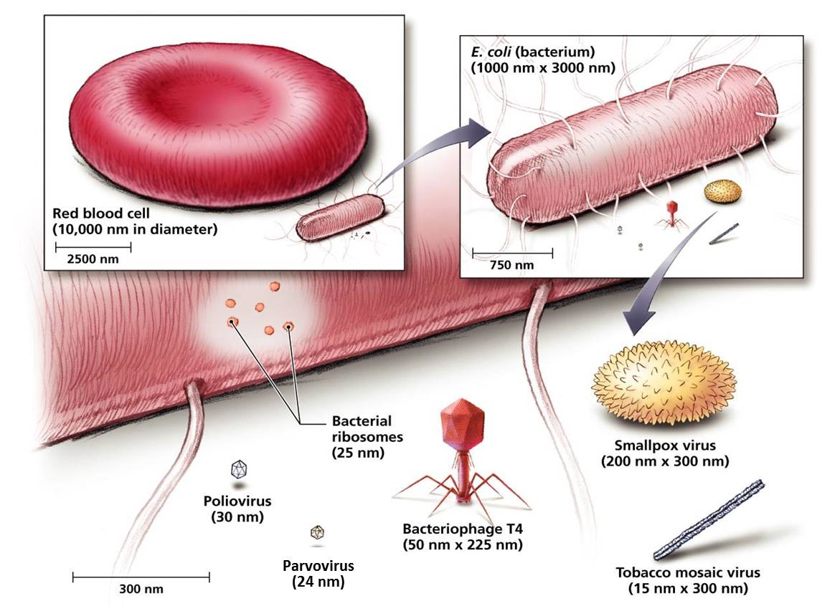
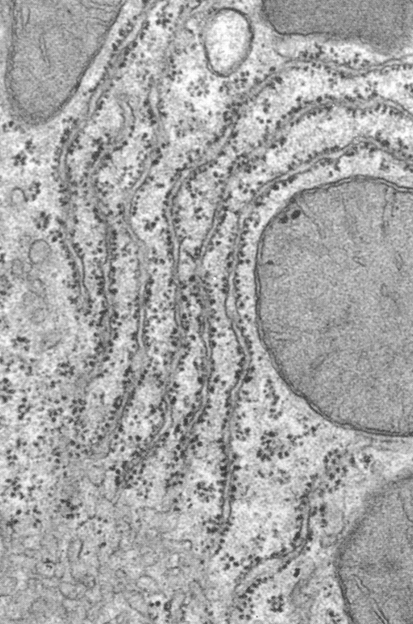
Morphology and Size of Selected Virions
MVM has a similar size as a ribosome
Notes:
Viruses can differ significantly in size
smallpox: very complex dimension: 200 by 300 nm
TMV: can be 300 nm in length
Other viruses like Parvoviruses and Polioviruses much smaller having a size of only 25-30 nm
This picture is for the Polaceck group.. Parvovirus same size as ribosom
Hence, the prefix parvum which means small in latin

Slide 5
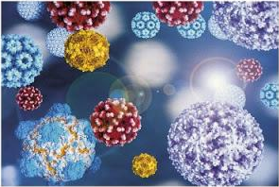

Why are Parvoviruses Interesting?
Important Human Pathogens
B19V, Bocavirus, PARV4, …?
Vectors for Gene Therapy
AAV
Infects humans
Non-pathogenic in humans
Dominant phase of the life cycle: persistent or latent phase
→ site-specific integration into chromosome 19
→ e.g. Glybera for the treatment of lipoprotein lipase (LPL) deficiency
Tools to study host virus interactions
Due to their simplicity parvoviruses strongly depend on their
host cell.
Oncolytic and Oncotropic Properties
Rodent parvoviruses: H1-PV / MVM
Worst Case Models for Pathogen Safety in Industry (Biologics)
Highly robust animal parvoviruses (MVM, CPV, PPV,..)
Notes:
After the general introduction → PARVOVIRUSES
Why is it interesting to study their biology?
First of all, important human pathogenes → can cause severe disease
Erythroparvovirus B19
human bocaparvovirus
tetraparvovirus PARV4
Furthermore AAV represents a further human non-pathogenic parvovirus
can site-specifically integrate into human chromosome 19 where it can persist
used as a vector for gene therapy
Moreover, Simplicity → strongly depend on host cell
interesting tools to study those immense host-virus interactions
Next, latter point is in connection with their natural oncolytic and oncotropic properties
elevated proliferation → cancer cells offer a perfect environment → hijack the cellular machinery
primary cell line of normal origin resisted parvovirus infection but transformed counterparts were sensitive to cytopathic effect
Finally, compact structure and fact that the lack an envelope
highly resistant to lipid solvents, alcohol and ether treatments, as well as temp treatment up to 60 °C
stable at pH range 3-10
robustness → worst case models to challenge the inactivation or elimination procedures production of biologics

Slide 6
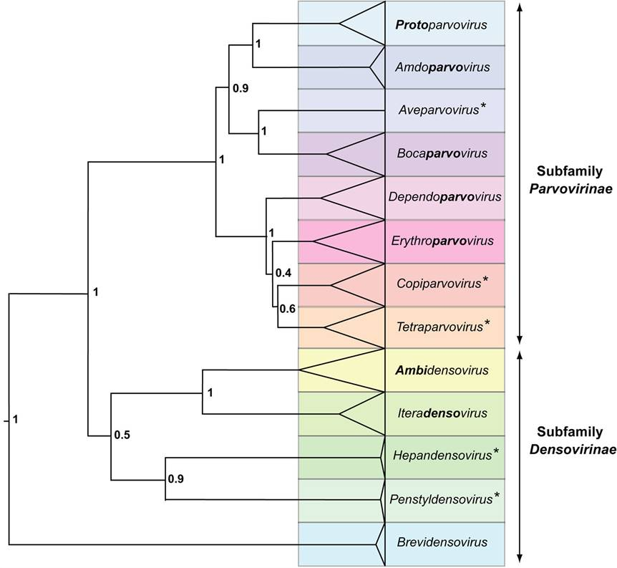

Taxonomy of the Family Parvoviridae
Genera
Subdivision based on
Transcription map
Organization of the ITRs
Ability to replicate autonomously or with a helper virus
Sense of the ssDNA genome
Sequence homology amongst the subfamily
MVM
Infecting vertebrates
Infecting insects and other arthropods
Notes:
Parvoviridae family vast genetic divergence → high mutation rates of parvoviruses similar to RNA viruses.
the subfamilies Parvovirinae infecting vertebrates and Densovirinae
further subdivided into 8 genera based on
Minute virus of mice is the type species of the genera PROTOPARVOVIRUS

Slide 7

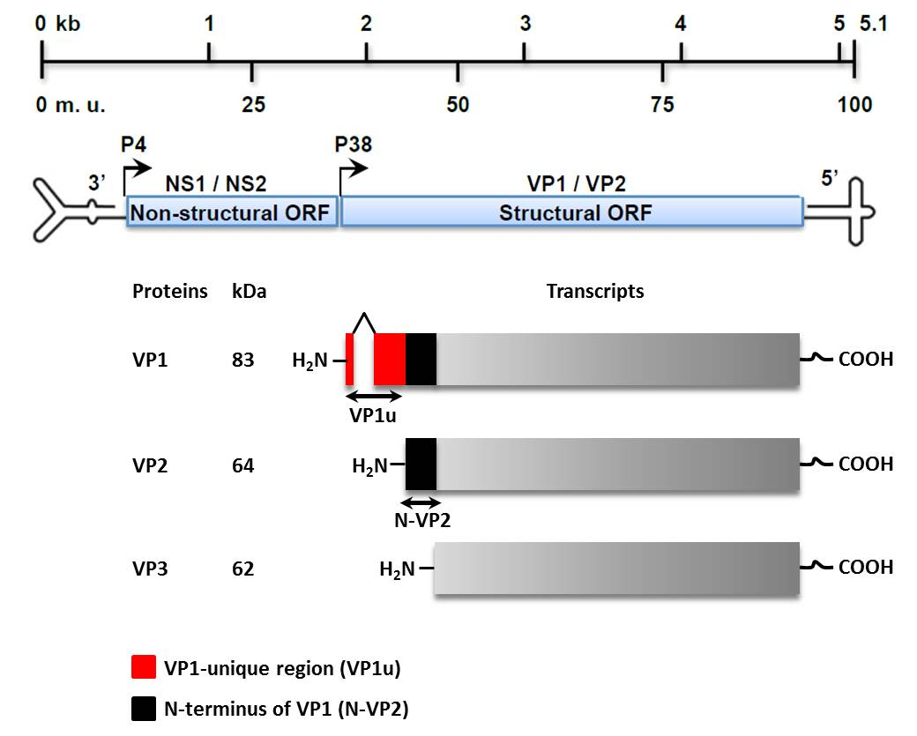
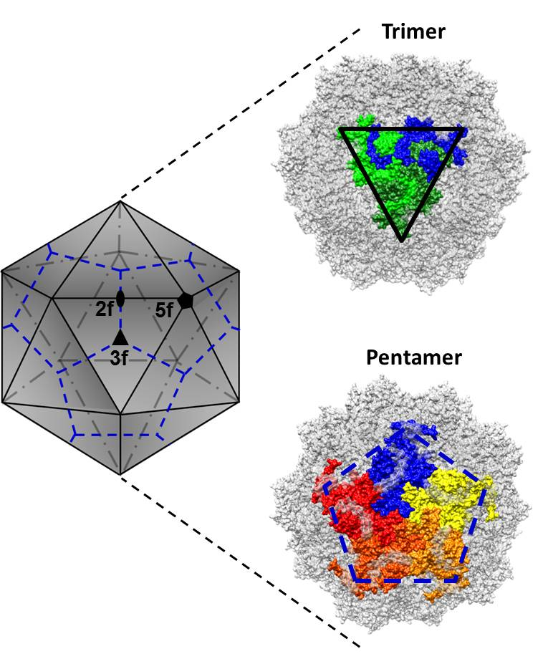
Structure of MVM
T = 1
VP2
Notes:
Viral genome organized in two ORFs non-structural, structural
Capsid made up of 60 copies of a single polypeptide sequence
Icosahedron with T=1
Structural proteins of three size classes → share the same C-terminal core structure
10 copies per particle of VP1 whereas VP2 major structural capsid protein
Intracellular proteolytic digestion during entry of virion → cleavage of (N-terminal part of VP2) N-VP2 to generate VP3 → truncation of approx. 25 aa
Important:
The N-terminal regions of VP1 (VP1u) and VP2 (N-VP2) are highly flexible and can be externalized through the 5-fold pore of the capsid. They have important functions during the life cycle of MVM and particularly keep in mind N-VP2 which will be important to better understand my project.

Slide 8
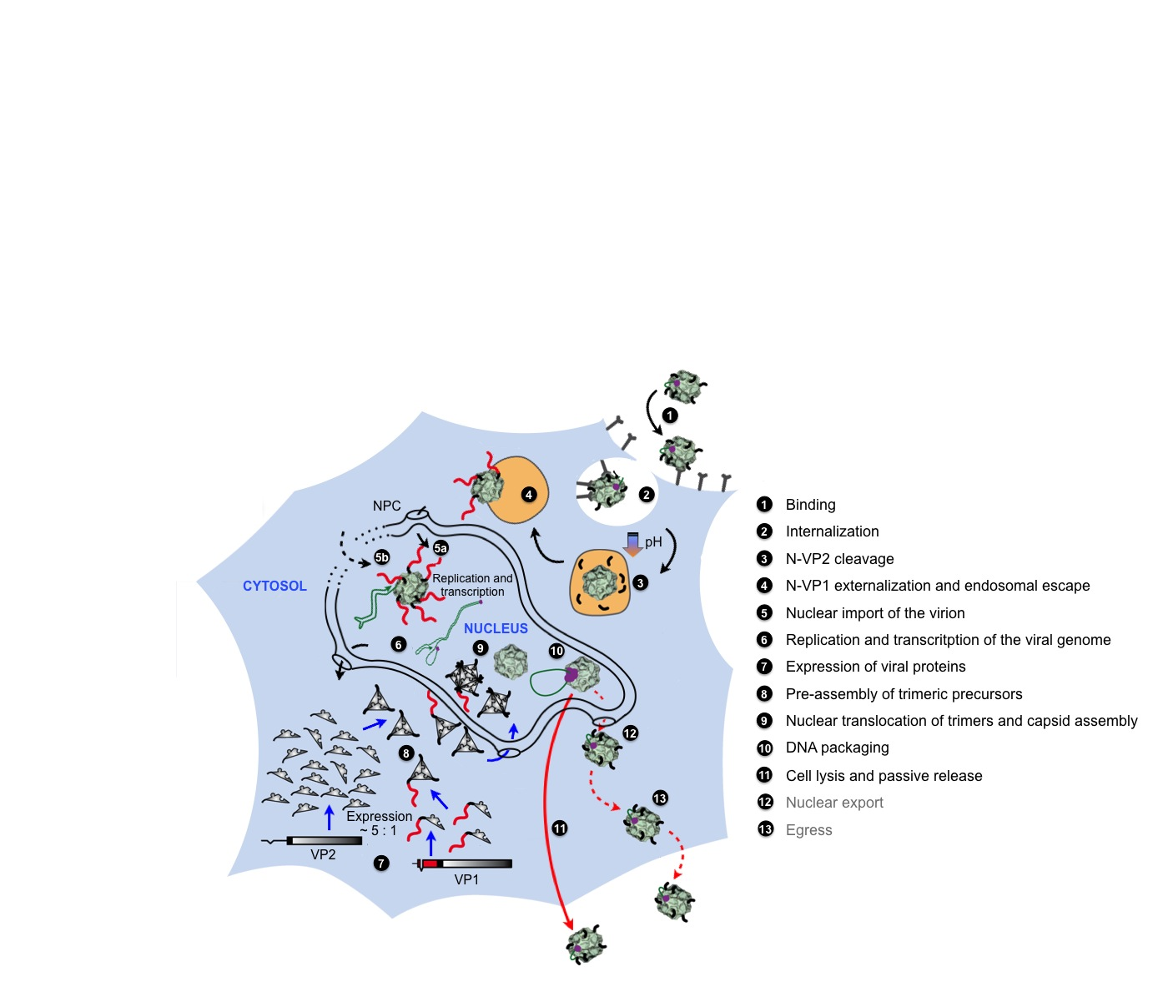
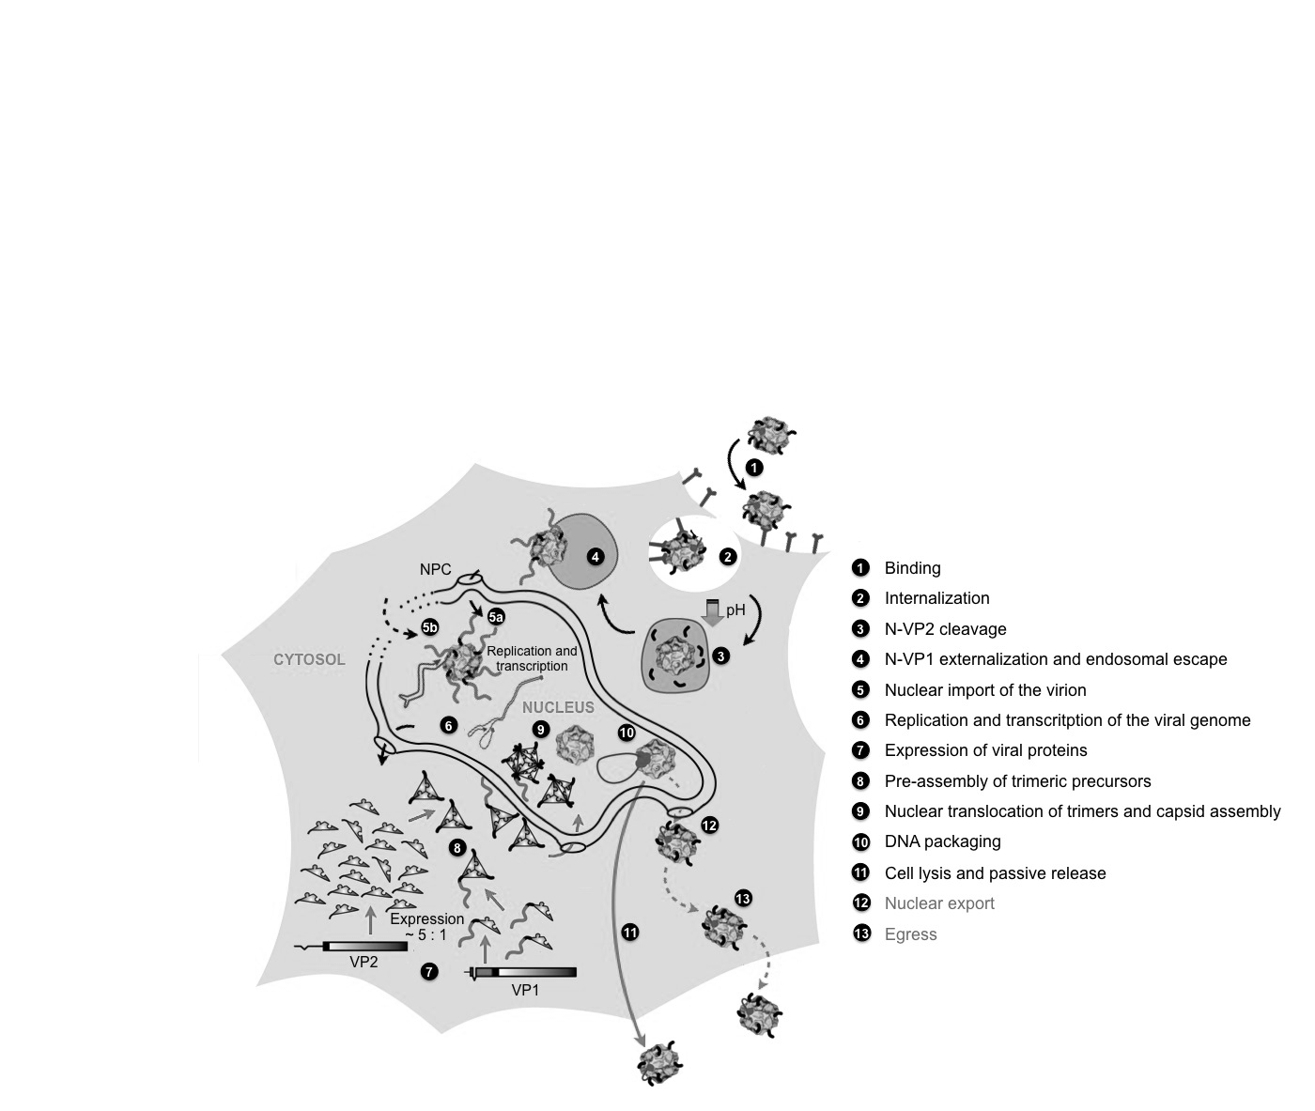


Life Cycle of MVM
Is there a Pre-Lytic Active Egress of MVM?
Nuclear Export and Egress
There is growing evidence that an active egress precedes passive cell lysis
Notes:
Binding enables first step of infection, important key parameter of tropism and pathogenesis
For MVM only glycan component is known → primary attachment factor is Sialic Acid
Internal. Enters the cell by clathrin-mediated endocytosis within the endosomes → important structural transitions
cleavage of exposed N-VP2 termini and externalization of VP1u
End. Esc Endosomal escape → major barrier for subsequent steps
Most Incoming viruses fail to enter the nucleus → relatively high particle to infection ratio
suggested: PLA2 activity within VP1u mediates endosomal escape
m→ however, site of endosomal escape unknown
Cyt Traff. Free diffusion restricted through lattice-like mesh of intermediate filaments and microtubules
Active, dynein-mediated transport → requires functional cytoskeleton
Proteasome essential but no particle ubiquitination was observed
Nuc Targ. Viral structural components .. Two stages of the viral life cycle
Early → incoming virion, DNA delivery, late in infection → struct. Proteins → self-assembly
Nuclear import is highly controversial
small size → intact, but presence in nuclei not yet been demonstrated
In general: MVM enters the nucleus through the NPC by exposing NLS → However, report suggests
NPC-independent pathway involving Caspase-3 mediated degradation of nuclear lamina
De novo synthesized structural proteins → preassemble → trimeric assembly intermediates → import → self-assembly to EC
Replication Unique single-stranded linear DNA genome → exclusive replication strategy
→ rolling hairpin replication
NS1 and hairpins → melt DNA and re-direct replication fork
Packaging single stranded DNA is packaged into pre-assembled virions in an NS1-dependent manner
My resear focuses last steps of life cycle, unknown how progeny is released, considered a passive process
associated with NS1-induced lysis, growing evidence active export and egress precedes passive release

Slide 9

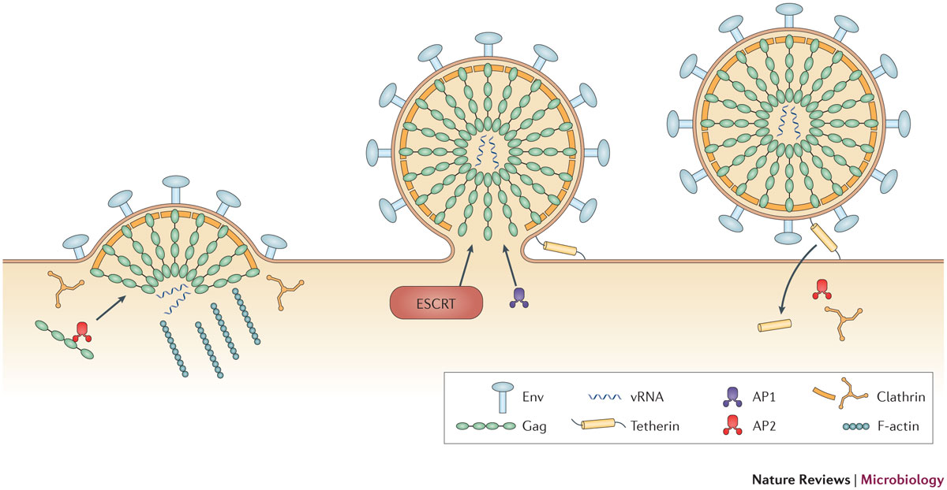
Egress: Basic Principle of Virology
Non-enveloped viruses: Cell lysis and passive release of progeny virions.
(poorly understood)
Examples
Adenovirus
Parvovirus
Polyomavirus
Reovirus
Enveloped viruses: Budding through host cell membranes.
(well characterized)
Examples
Retrovirus
Herpesvirus
Coronavirus
Poxvirus
Notes:
These observations → in conflict with the basic principle of virology
Considers release of non-enveloped → bare consequence of cellular lysis.
Active egress and non-lytikc budding through host cell membranes → enveloped viruses
Evidence of an active egress of non-enveloped viruses → mainly from polarized cells
Virus progeny predominantly released at the apical membrane.
→ Examples: SV-40, Simian Rotavirus, and Poliovirus

Slide 10
Nuclear Export of Minute Virus of Mice
DNA-packaging triggers N-VP2 externalization and nuclear export:
Pre-assembled empty capsid
Full capsid
Nuclear export incompetent
Nuclear export competent
Linear ssDNA genome
Genome packaging
Phosphoserine-rich N-VP2
Notes:
The mechanism for nuclear export of MVM remains elusive.
suggested → genome packaging into the pre-assembled empty calsids → N-VP2 externalization.
phosphoserine-rich N-VP2 residues → supposed to mediate nuclear export of only DNA filled capsids.
In such a way, empty capsids remain incompetent for nuclear export.

Slide 11
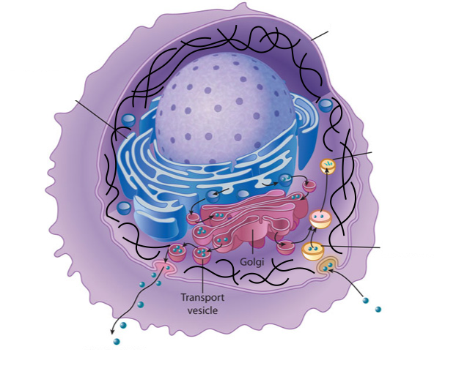
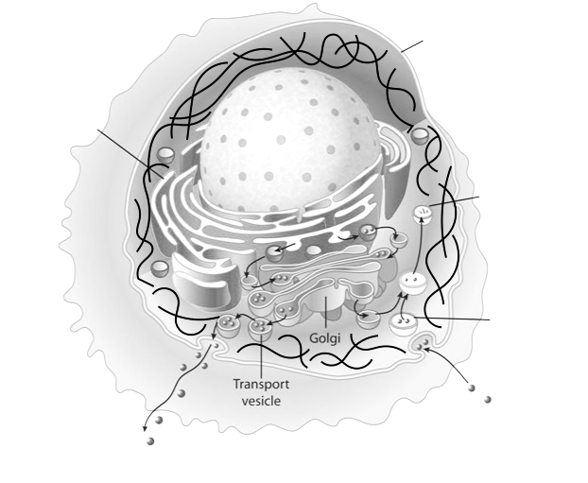
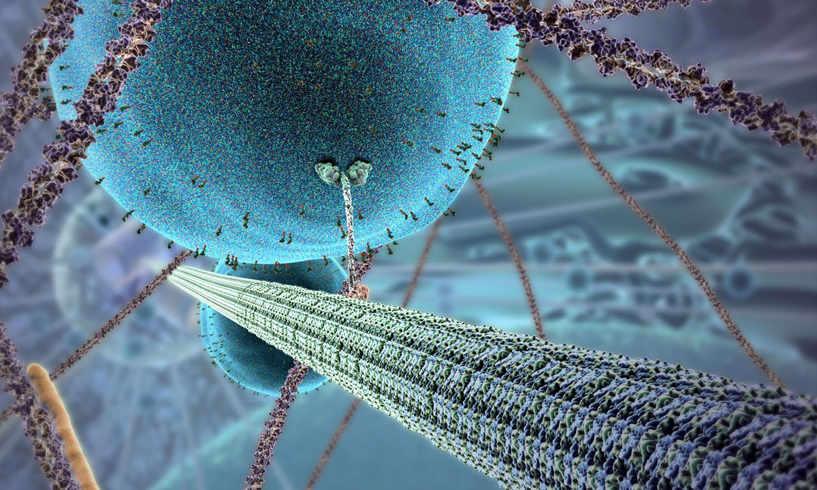
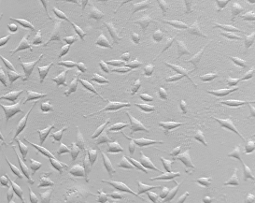
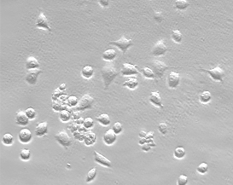
Egress of Minute Virus of Mice
The egress of MVM progeny is a regulated process involving COPII vesicles.
Exocytic vesicles are transported along microtubules mediated by kinesin.
Nucleus
Lysosome
ER
Microtubules are stabilized during the course of infection.
Dynamin accumulates in the perinuclear region where it co-localizes with MVM progeny virions.
Actin filament
Endosome
10 hpi
40 hpi
Actin filaments are depolymerized during the infection resulting in cell rounding eventually leading to cell death.
ENDOCYTOSIS
EXOCYTOSIS
Notes:
The exocytic pathway → ER and Golgi → proposed route for active egress of MVM.
MVM progeny → engulfed in COPII vesicles → accumulate with dynamin in the perinuclear area.
MVM egress induced gelsolin-mediated actin degradation → cell rounding.
However, microtubules → stabilized during an MVM infection.

Slide 12



Challenge
The documentation of active egress by non-enveloped viruses is a difficult task:
Lysis of a few cells passively releases progeny virions.
The discrimination between incoming and progeny virions remains difficult.
The entry and the proposed egress route partially overlap.
Parvoviruses, particularly MVM, are highly robust and can persist as intact particles in the lysosomes of infected cells.
I need a tool in order to separate intracellular viruses based on their maturation stage and surface properties.
Notes:
Documentation → active Egress → difficult task
Passively released virions → misinterpreted → particles that egress actively.
Even → 2nd round of infection
However, impossible → exclude → lysis of a few cells → passively releases progeny virions.
Parvoviruses (MVM) highly robust → persist intact in lysosomes
Moreover entry and proposed egress route partially overlap.
→ complicating discrimination between incoming and progeny virions
Therefore, tool to separate intracellular viruses according to their maturation stage and surface properties

Slide 13

Chromatofocusing: Separating Viruses
D440N MVM
CPV
MVM
R²=0.95
pI ≈ 6.0
pI ≈ 5.3
pI ≈ 4.3
Solution: Determination of IEPs of different viruses was possible by performing chromatofocusing!
Chromatography might be the way to overcome my problems.
Notes:
Short digression to another experiment
Needed to separate .. According to IEP
Unsuccessful trials in 0.8% agarose gels (IEF) → chromatofocusing through MonoP
Black: continuous pH gradient
MVM / CPV (canine parvovirus) → properly separated → eluted according IEP
Material → No absorbance → qPCR in each fraction
Measured the effect of a single point mutation → very surface, 3-fold spike
→ Major surprise!!
Removal of one single charge → dramatic shift → towards a more basic IEP
Shift can be explained → symmetry of the capsid
One point mutation repeated 60x with respect to the assembled particle
Chromatography valuable tool to detect minor changes → small non-enveloped viruses
Might help to separate intracellular viruses according to maturation stage and surface properties

Slide 14

Goals
Aim:
Confirmation of an active process of nuclear export and egress of MVM progeny virions.
Characterization of critical capsid maturation steps that trigger active pre-lytic egress of MVM.
Notes:
Aim → my PhD project → confirm the existence of a process for nuclear export and active egress of MVM progeny.
Furthermore → to understand the critical capsid maturation steps → trigger the active pre-lytic egress of MVM.

Slide 15

Strategy
Fast Protein Liquid Chromatography (FPLC)
Anion-exchange chromatography was performed to separate intracellular viral particles based on their surface properties.
Isolation
Purification
Concentration ...of distinct maturation intermediates
Standard biochemical and molecular biological methods
Investigation of structural and functional characteristics of the isolated populations.
Side-directed mutagenesis
The role of different capsid regions in egress of MVM was studied.
Notes:
Anion-exchange chromatography → to separate intracellular particles → surface properties.
AEX has several advantages: → one experiment I can isolate, purify, and concentrate
→distinct intracellular maturation intermediates.
standard biochemical and molecular biological methods:
structural and functional characteristics of the isolated populations were investigated.
site-directed mutagenesis → study → role of different capsid regions in nuclear export and egress

Slide 16
Isolation of Two Full Capsid (FC) Populations by AEX
AEX profile of MVM
DNase I treatment
Nuclei
(8 dpI)
(18 hpI)
FC-P₂
FC-P₁
FC-P₁
FC-P₂
Two distinct DNA-containing populations of MVM appear in the nucleus of infected cells.
FC-P₁ is predominantly associated with cells.
FC-P₂ is the predominant population in the SN.
Only one population of empty capsids (EC) was observed.
Notes:
Results. different anion-exchange chromatographs. → first one, progeny particles released in the SN of infected A9 mouse fibroblast cultures
→collected 8dpI when the cytopathic effect was complete. →particles were precleared and analyzed by AEX.
→quantified by qPCR. Two distinct virus populations were separated (grey).
In parallel, → second AEX-qPCR analysis was performed including both medium and cell lysate.
By including the additional intracellular viruses the same two populations were detected but with altered proportions (black).
verify the integrity of the two DNA containing populations, → subjected to nucleolytic digestion. Both resist DNase I digestion,
indicating that they represent assembled DNA containing particles.
capsid assembly occurs in the nucleus → of interest to verify their presence in the nucleus at the onset of DNA packaging and assembly.
As shown here, both DNA containing particles co-existed in the nucleus in similar amounts 18 hpI.
AEX profile of pre-assembled empty capsid precursors → purified by CsCl gradient centrifugation → subjected to AEX.
Dot-blot analysis using an ab against intact capsids → their AEX profile resembled that of the FC-P1 population.
FC-P1 particles are pre-dominantly cell-associated → similar AEX profile as the EC precursors
tempting to speculate that they represent immature particles without egress potential
FC-P2 display a further maturation step which enables active release.

Slide 17
FC-P₁ and FC-P₂ Differ in N-VP2 Conformation
Both DNA-containing populations are infectious.
Only FC-P₂ exposes the N-terminal part of VP2 (N-VP2).
DNA packaging is not sufficient for N-VP2 externalization!
α-Capsid mAb
α-N-VP2 pAb
FC-P₁
FC-P₂
Notes:
Further characterize populations → intensively purified → applying them to AEX twice.
Used to infect A9 cells → investigate capacity to initiate infection.
Both capsid pop. able to reach the nucleus → genome was replicated efficiently
Represent infectious virions
As explained previously → DNA-packaging has been suggested to trigger N-VP2 exposure
Therefore → analyzed the surface conformation of N-VP2 → two FC populations by IP
→a specific antibody raised against this region.
N-VP2 occupies a surface position in FC-P2 virions but is sequestered in FC-P1.
IF → virion progenies bound similarly to A9 cells
N-VP2 of FC-P2 → detectable on the surface of the cells.
→ N-VP2 was not accessible to specific antibodies → FC-P1 particles.

Slide 18
N-VP2 Externalization of FC-P₁ Can Be Enforced
*
* CHT: α-Chymotrypsin
N-VP2 externalization does not influence the AEX profile!
N-VP2 externalization of FC-P₁ particles is triggered by incubation at low pH or by treatment at 50 °C.
In vivo, the cleavage of N-VP2 is less efficient for FC-P₁ virions.
Notes:
CHT → mimick the in vivo cleavage of N-VP2 → occurs in endosomes, entry
EC do not expose N-VP2 → not accessible to prot. Digestion
Purified capsid pop. Separately subjected to prot. Digestion by CHT → Neutral or acidic cond.
FC-P2 completely processed under all tested cond. → In contarst, N-VP2 of FC-P1 → only marginally
Accessible to CHT under neutral cond. → required acidification to improve cleavage rate.
!!! Substantial amount of VP2 that remained unprocessed → EC which elute in the same AEX fractions as FC-P1 → but not cleavable
Increased exposure of N-VP2 of FC-P1 under acidic cond. Or increased temp. → confirmed by IP (spec. ab)
When inc. with cells: N-VP2 of FC-P1 became exposed following internal. and a proportion remained detectable for several hpI.
Indicates slower processing of VP2 to VP3
We next investigated whether the sequestered N-VP2 conformation of FC-P1 is responsible for its distinct AEX profile. Therefore, FC-P1 virions were exposed to acidic conditions to provoke N-VP2 externalization. When we analyze their AEX-qPCR it shows that despite the externalization of N-VP2 the AEX profile remained unchanged. Accordingly, the distinct N-VP2 conformation is not responsible for the different AEX profile.

Slide 19
Surface Phosphorylations Determine the AEX Profile
WT + λ-Phosphatase
5SG Mutant
5SG Mutant + λ-Phosphatase
FC-P₂ virions contain additional surface phosphorylations.
The corresponding surface phosphorylations are not located within N-VP2.

Slide 20
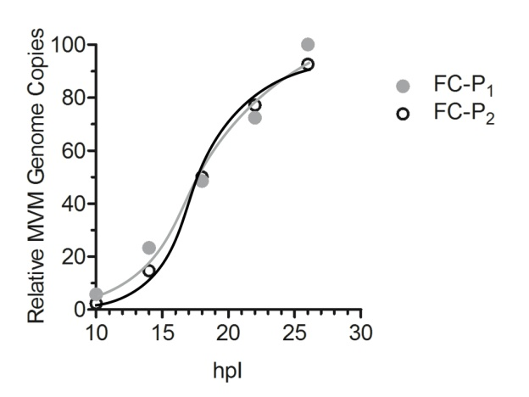
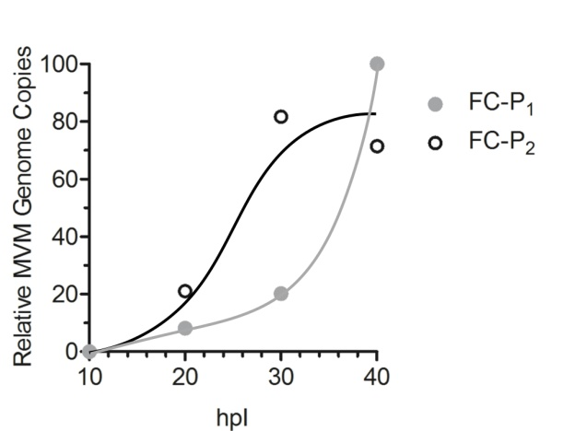
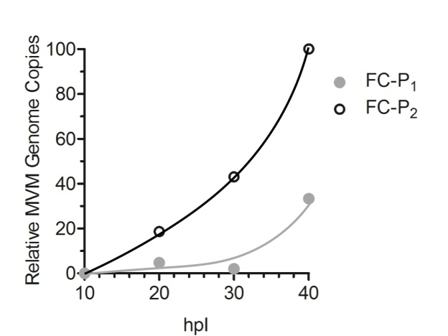
FC-P₂ Can Actively Egress from the Infected Cell
Nucleus
Cytoplasm
Supernatant
Only FC-P₂ has nuclear export potential and can actively egress from the infected host cell.
Onset of cytosysis

Slide 21
Nuclear Accumulation of FC-P₁ Precedes that of FC-P₂
FC-P₁ is the first population to occur in the nucleus of infected murine A9 and human transformed NB324K cells.
In NB324K cells FC-P₁ disappeared progressively to give rise to FC-P₂.
In A9 cells this transfer was less efficient, leading to the accumulation of both populations.

Slide 22
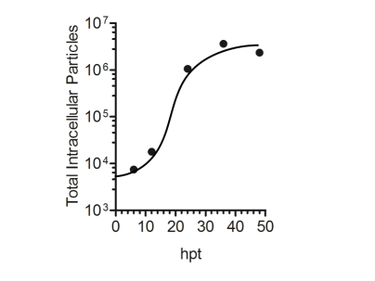
FC-P₁ is the Precursor of FC-P₂
Transfection in NB324K
IP using α Capsid mAb
FC-P₁ is the precursor of FC-P₂

Slide 23
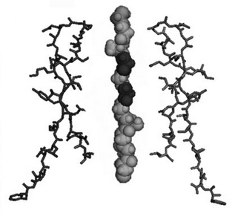
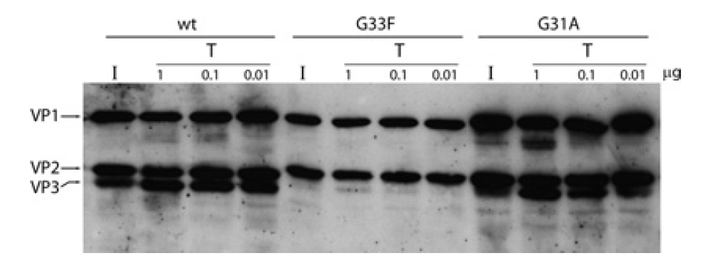
N-VP2 is Dispensable for Active Egress
5-fold channel
24 hpT
OUTSIDE
G33F
N-VP2 is not required for active egress of MVM.
INSIDE
24 hpT
G33F does not expose N-VP2, thus it is not cleaved upon proteolytic digestion.
Castellanos M, Pérez R, Rodríguez-Huete A, Grueso E, Almendral JM, Mateu MG. A slender tract of glycine residues is required for translocation of the VP2 protein N-terminal domain through the parvovirus MVM capsid channel to initiate infection. Biochem J. 2013 Oct 1;455(1):87-94.

Slide 24
In vivo Dephosphorylation can be Mimicked in vitro
in vivo
in vitro
Incoming
virions
FC
-
P
FC
-
P
FC
-
P
FC
-
1
2
1
P
2
5 min
FC-P₂ particles are processed to generate FC-P₁-like particles.
Acidic endosomal phosphatases remove the surface phosphorylations.
Baf A₁, an inhibitor of the vacuolar-type H⁺-ATPase, abrogated the dephosphorylation of the incoming FC-P₂ population.
6 h
+
CHT
6 h
+ CHT
and
+
BafA
Phosphatase
1
Baf A₁: Bafilomycin A₁
CHT: α-Chymotrypsin

Slide 25
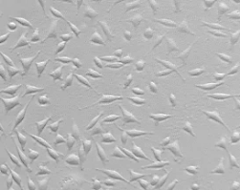
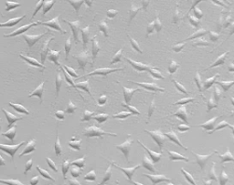
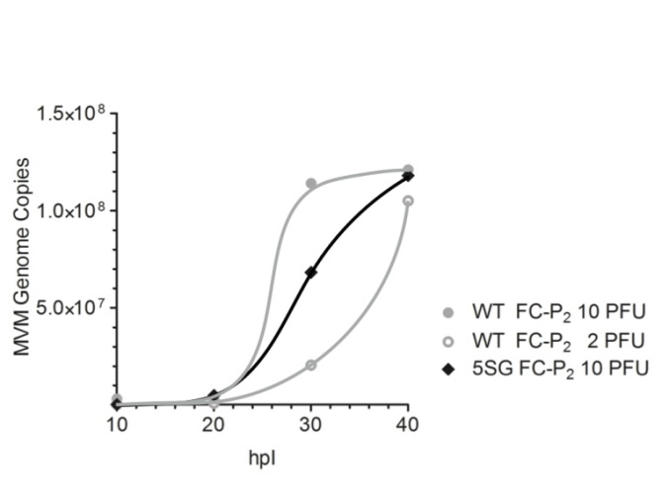
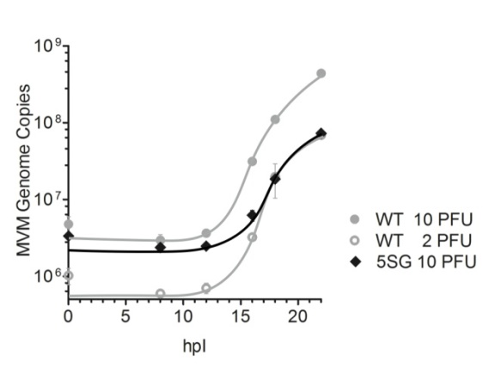
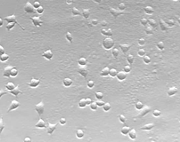
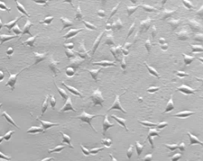
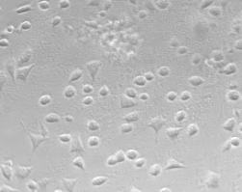
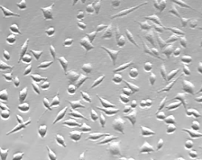
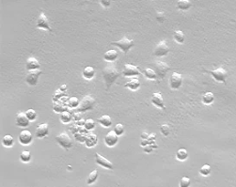
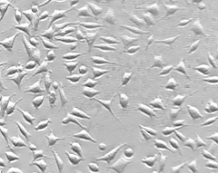
The Role of N-VP2 in MVM Infection
Cytotoxicity
WT
5SG
Nuclear import
(Viral DNA replication)
Nuclear export
10 h
99 %
99 %
20 h
100 %
96 %
5SG is less efficient in replicating viral DNA in the nucleus, indicating that fewer virions reached the nucleus.
Nuclear export of 5SG progeny is not significantly affected.
The phosphorylations on N-VP2 are likely involved in late events mediating the rearrangement of the cytoskeleton during egress.
30 h
98 %
90 %
40 h
58 %
88 %

Slide 26

Conclusion
Anion-exchange chromatography allowed the separation of two different populations of DNA-containing virions.
The populations differed in the conformation of their N-VP2 termini and their surface phosphorylation status.
Nuclear export and active egress prior to cytolysis was observed only for the late FC-P₂ population, resulting in a segregation of the two progeny populations.
N-VP2 is not significantly involved in nuclear export and active pre-lytic egress of MVM. However, it might facilitate cytolysis and passive egress.
The surface phosphorylations are strictly associated to nuclear export potential. Moreover, they are removed from incoming virions during endosomal trafficking.
These temporally and spatially controlled changes in surface phosphorylations would provide nuclear import and export potential required to fulfill the complete life cycle of a karyophilic virus.

Slide 27
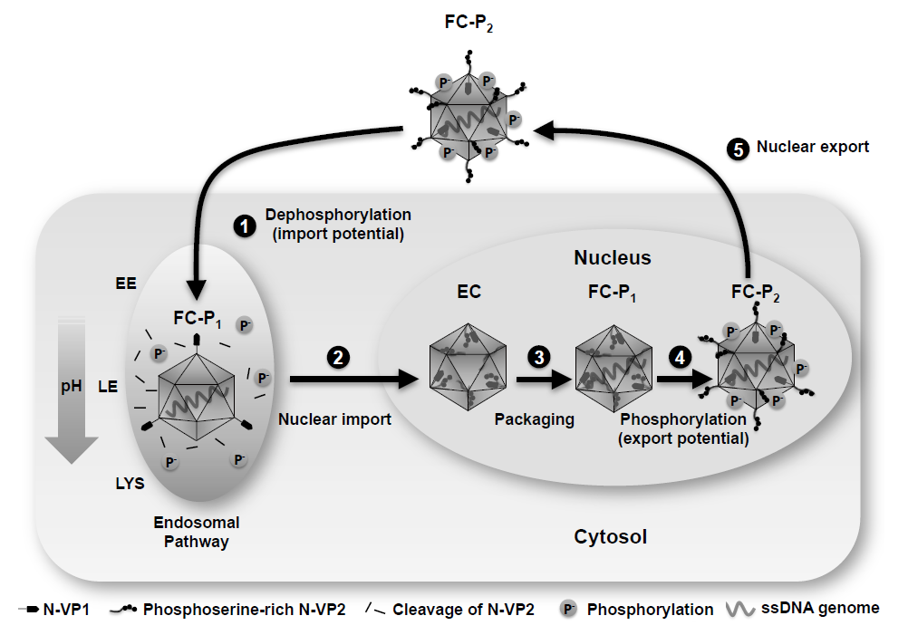
Conclusion

Slide 28

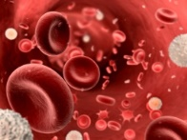
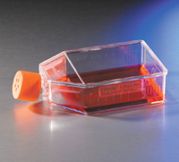
Outlook
MVM
Identification of the surface phosphorylations which cause the different AEX profiles.
Characterization of the nuclear export and egress of the corresponding mutants.
Investigation of the role of the serine-rich N-VP2 in cytotoxicity and characterization of the underlying mechanism.
Other Parvoviruses
A
B19V
B
CPV
Cell culture:
Pre-mature and mature virions are not separated
Bone marrow:
Site of production
Blood:
Mature virions
C
D
E
F
B19V purified from plasma
B19V binding
B19V internalization
(3 h)
CPV SN + Cell

Slide 29




Acknowledgements
It is a pleasure to thank those who made my thesis possible…
Christoph Kempf
Carlos Ros
Nico Ruprecht
Remo Leisi
Marcus von Nordheim
Michel Boinay
Alessio Loffreda
Aurélie Allemann
Chiarina Di Tommaso
Seline Zürcher
Achim Stocker
Walter Aeschimann
José María Almendral
Carlos Dominguez Redondo
Jon Gil Ranedo
Josefa González Nicolás
Marta Pérez Illana
Aroa Tato de la Torre

Slide 30

Questions

Slide 36
Outlook
Identification of Phosphorylations
Role of N-VP2 in cytotoxicity

Slide 37
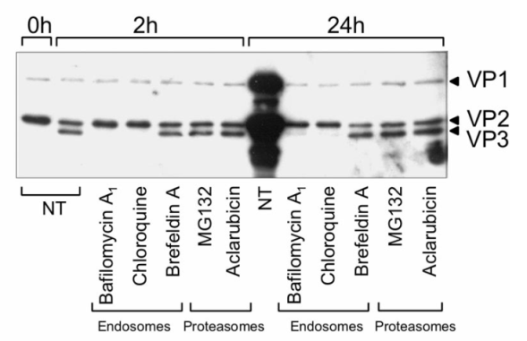
FC-P₁
FC-P₂
5 min
6 h
6 h
+ BafA₁
Mani B, Baltzer C, Valle N, Almendral JM, Kempf C, Ros C. Low pH-dependent endosomal processing of the incoming parvovirus minute virus of mice virion leads to externalization of the VP1 N-terminal sequence (N-VP1), N-VP2 cleavage, and uncoating of the full-length genome. J Virol. 2006 Jan;80(2):1015-24.

Slide 38
Basic principle in virology:
The egress of enveloped viruses is well characterized and involves budding trough host cell membranes .
The release of non-enveloped viruses is considered a passive process because it is associated with cellular lysis.
Several recent studies challenge this basic principle suggesting an active egress mechanism for non-enveloped viruses.
Review: Nuclear Import/Export … find also nice illustration for conclusion..

Slide 39
WT
G33F Mutant
ssDNA
N-VP2 with serine phosphorylations
N-VP2 of 5SG mutant
F
G33F
H₂N MSDGTSQPDSGNAVHSAARVERAADGPGGSGGGGSGGGGVGVSTGS COOH
1
5
10
15
20
25
30
35
40
45

Slide 40
A9
NB324K
(Murine fibroblasts)
(Human transformed cells)
FC-P₁
FC-P₂
FC-P₁
FC-P₂
10 h
10 h
FC-P₁
FC-P₂
24 h
14 h
14 h
48 h
18 h
18 h

Slide 41
WT
5SG Mutant
ssDNA
N-VP2 with serine phosphorylations
N-VP2 of 5SG mutant
G
G
G
G
G
H₂N MSDGTSQPDSGNAVHSAARVERAADGPGGSGGGGSGGGGVGVSTGS COOH
1
5
10
15
20
25
30
35
40
45

Slide 42
Why are Parvoviruses Interesting?
Advantages
Extremely robust
Non-enveloped
Very small
18-24 nm
Human pathogens
B19V, Bocavirus, PARV4, …?
Applications
Well characterized
Animal parvoviruses
Oncolytic capacity
Gene therapy
AAV gene therapy vectors
Pathogen safety (Worst case models)
Animal parvoviruses (CPV, MVM)

Slide 43
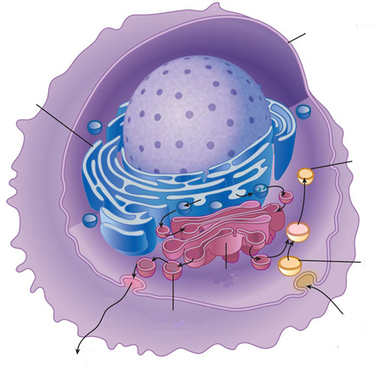
Cell Membrane
Egress of progeny virions from the nuclear periphery to the plasma membrane through ER and Golgi is a regulated process involving COPII vesicles (Bär et al., 2008). This pathway is not only needed to induce post-assembly modification to mature progeny particles, but also for the coordinated release of virions by induction of cytolysis (Bär et al., 2013).
Endoplasmic Reticulum
Lysosome
Endosome
ENDOCYTOSIS
EXOCYTOSIS

Slide 45
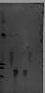
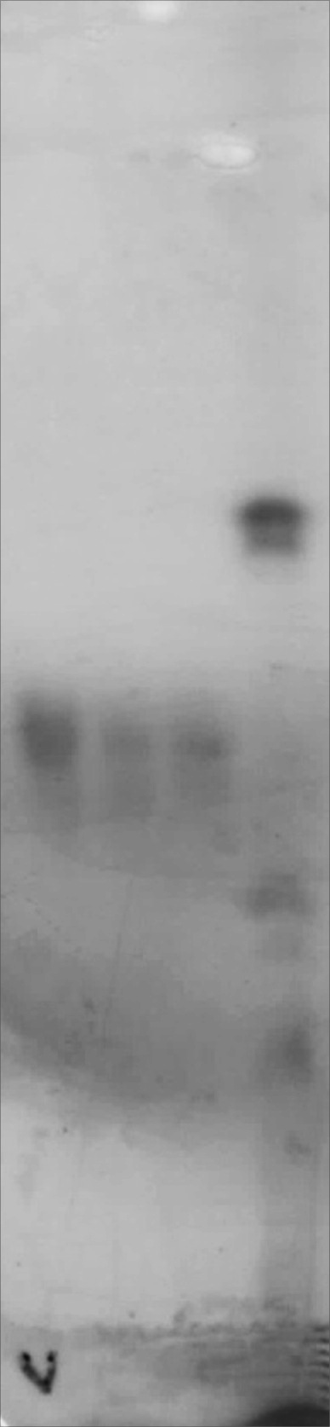
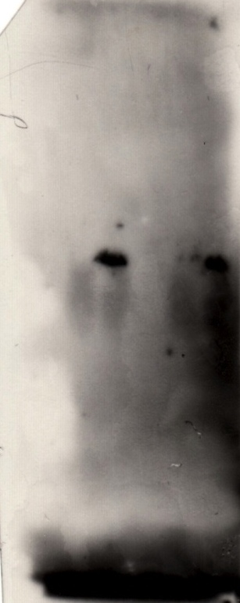

Iseolectric Focusing
BSA
Carboanhydrase
90 ug
60 ug
120 ug
10⁸ EC
10⁸ FC
10⁹ EC
pI
BSA
pI
10⁹ FC
pI
6.0
6.0
6.0
5.9
5.3
5.3
5.3
5.2
5.2
5.2
4.7
4.7
4.7
Sample Application
4.5
4.5
4.5
4.2
4.2
4.2
3.8
3.8
3.8
Problem: Mobilization of viral particles in 0.8% agarose gels.

Slide 46
https://www.google.ch/search?q=troubles&biw=1440&bih=791&source=lnms&tbm=isch&sa=X&ved=0CAYQ_AUoAWoVChMIiNye_fHVyAIVy7UUCh0tLgAL#tbm=isch&tbs=rimg%3ACfBW0KVwiI7TIjg31otRmn6caT--lbTycMGHYK4saJI8YczwWLyHRS9PEaAzxEfPCNUjZ3Apqw1jOMzNccBxvDR5ZCoSCTfWi1GafpxpEfTxbQVmA89_1KhIJP76VtPJwwYcRLk9jT-LN5JEqEglgrixokjxhzBEsthGRwrZNRSoSCfBYvIdFL08REfNnFD4bQMnRKhIJoDPER88I1SMRdzeQcUqvON8qEglncCmrDWM4zBE2iZ237eVbRSoSCc1xwHG8NHlkEc1fMjr_1GaaN&q=Problem%20m%C3%A4nnlein&imgrc=dLB2ZGnQj4_liM%3A

Slide 47
The assembly of retroviruses requires three major components: Gag, envelope protein (Env) and the genomic viral RNAs (vRNAs). These components are transported to distinct sites in the plasma membrane, where retroviral assembly and budding occur. Budding is coordinated through late domains in Gag, which facilitate the interaction of Gag with components of the ESCRT (endosomal sorting complex required for transport) machinery and thus coordinate outward membrane deformation. The endocytic and cytoskeletal machineries have been implicated in the budding process, but their precise roles remain unclear. To date, proposed mechanisms include the binding of adaptor protein complex 2 (AP2) to Gag to restrict Gag localization to the plasma membrane, as well as binding of AP1 to Gag and components of the ESCRT complex to facilitate budding by an unknown mechanism. In addition, clathrin localizes to the budding site and becomes incorporated into the viral particle, and thus might regulate the spatial organization of viral proteins to facilitate accurate assembly. The cytoskeletal machinery is implicated in providing force to promote efficient assembly and budding; however, as yet, no interplay between the endocytic proteins and actin has been observed in this system. To allow a progeny virus particle to be released, the host protein tetherin, which physically tethers the particle to the plasma membrane, must be counteracted. Both AP2 and clathrin have been implicated in the removal of tetherin from the budding site

Slide 48


Karyophilic Viruses
Advantages
Disadvantages
Use of cellular DNA and RNA polymerases.
Advantage of the RNA-splicing machinery for RNA processing.
Exploitation of the cellular chromatin for integration into the host’s genome.
Nuclear import and export required
→ nuclear envelope as an additional obstacle
Consequences
Nuclear import
Nuclear export
of the incoming viral genome
of non-structural, regulatory viral proteins
of de novo synthesized viral structural proteins
of transcribed mRNAs for translation in the cytosol
of assembled viral capsids and nucleoproteins

Slide 49
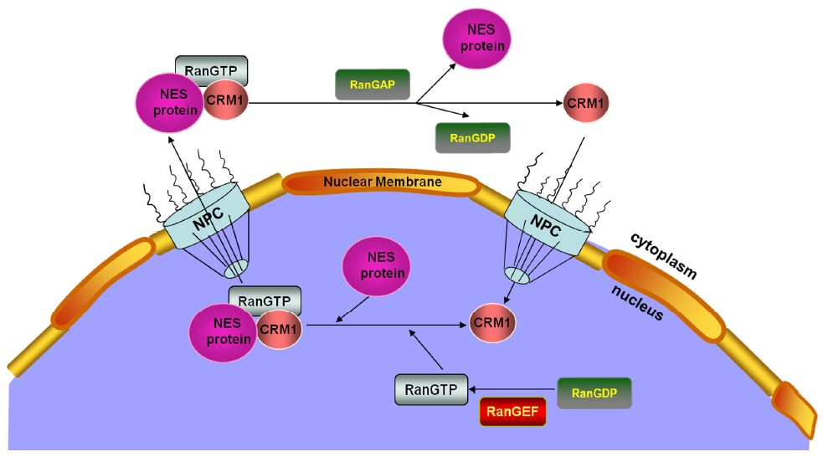
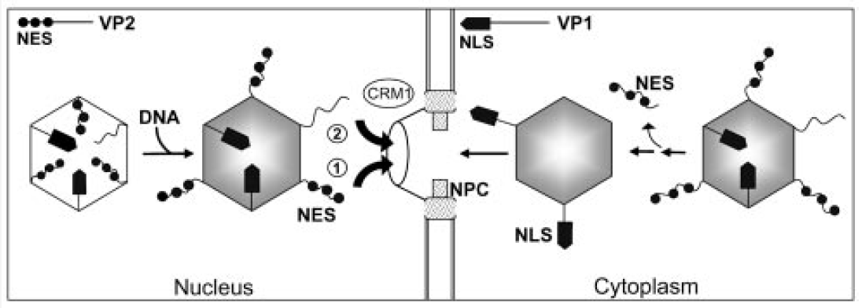
Nuclear Export
Classical model for nuclear export:
RAN-GTP-Exportin Complex binds to Cargo protein, resulting in nuclear export.
Cargo is released in the cytoplasm upon hydrolyzation of Ran-GTP to Ran-GDP.
Current model for MVM nuclear export:
Phosphorylations have been demonstrated to regulate nuclear import and export by masking NLS or NES sequences or by the introduction of conformational changes.
①
NES activity of highly phosphorylated N-VP2 in transformed cells
②
Nuclear export is Crm1 dependent in normal murine fibroblasts.

Slide 50
Mono Q HR 5/5
Column
Column i.d. | 5 mm
Bed Height With One Adaptor | 35 mm-59 mm
Bed Height With Two Adaptors | 8 mm-56 mm
Complete Packsize | 1 Piece
Chemical Stability | Resistant to most solutions used in liquid chromatography except Hydrocarbons, Aromatic solvents and Chlorinated Hydrocarbons
Material [Column Hardware] | Borosilicate Glass, Polyetheretherketone (PEEK), Polypropylene (PP), Ethylene Propylene Diene Monomer (EPDM) and Perfluoro-rubber (PFR)
Material [Column Tube] | Borosilicate Glass
Material [Bed Support] | Polypropylene (PP) filter
Bed Support | Filter
Bed Volume | 1 ml
Complete Packsize | 1 ml
Flow Rate | 0.5 ml/min - 3.0 ml/min¹⁾
Pressure Max. [Over the Packed Bed During Operation] | 40 bar [4 MPa] (580 psi)
Order Information | Not suitable for use with ÄKTAprime plus system.
Recommended Flow Rate | 0.5-3.0 ml/min
Storage Conditions | 4 to 30°C, 20% Ethanol
Dynamic Capacity | 50 mg
Media
Ligand | O-CH2-CHOH-CH2-O-CH2-CHOH-CH2-N+(CH3)3
Average Particle Size | 10 µm
Ion Exchanger Type | Quaternary ammonium strong anion
Matrix | Monodisperse porous polystyrene/divinyl benzene beads
Ionic Capacity | 0.27-0.37 mmol Cl⁻/ml
pH Stability Working Range | 2-12
pH Stability Cleaning | 1-14
Storage Conditions | 4 to 30°C, 20% ethanol
Chemical Stability | Stable in all common buffers except high concentration oxidizing and reactive agents, DMSO, DMF, and formic acid

Slide 51
Mono P 5/200 GL
Bed Volume | 4 ml
Bed Dimensions | 5 x 200 mm
Storage Conditions | 4°C to 30°C, 20% Ethanol
Pressure Max. [Over the Packed Bed During Operation] | 40 bar [4 MPa] (580 psi)
Column
Complete Packsize | 1 Piece
Column i.d. | 5 mm
Bed Height With One Adaptor | 185 mm-209 mm
Bed Height With Two Adaptors | 158 mm-206 mm
Chemical Stability | Resistant to most solutions used in liquid chromatography except Hydrocarbons, Aromatic solvents and Chlorinated Hydrocarbons
Material [Column Hardware] | Borosilicate Glass, Polyetheretherketone (PEEK), Polypropylene (PP), Ethylene Propylene Diene Monomer (EPDM) and Perfluoro-rubber (PFR)
Material [Column Tube] | Borosilicate Glass
Material [Bed Support] | Polypropylene (PP) filter
Bed Support | Filter
Porosity | 1 μm
Media
Ligand | Mixed quaternary and tertiary amines
Average Particle Size | 10 µm
Ion Exchanger Type | Chromatofocusing (weak anion exchanger)
Matrix | Monodisperse polystyrene/ divinyl benzene
Binding Capacity/ml Chromatography Medium | 0.15 to 0.21 mmol Cl⁻
Ionic Capacity | 0.15-0.21 mmol Cl⁻/ml
Storage Conditions | 4 to 30°C, 20% Ethanol
Chemical Stability | Stable in all common buffers except high concentration oxidizing and reducing agents, DMSO, DMF, formic acid, and some detergents

Slide 52
DNaseI treatment

Slide 53
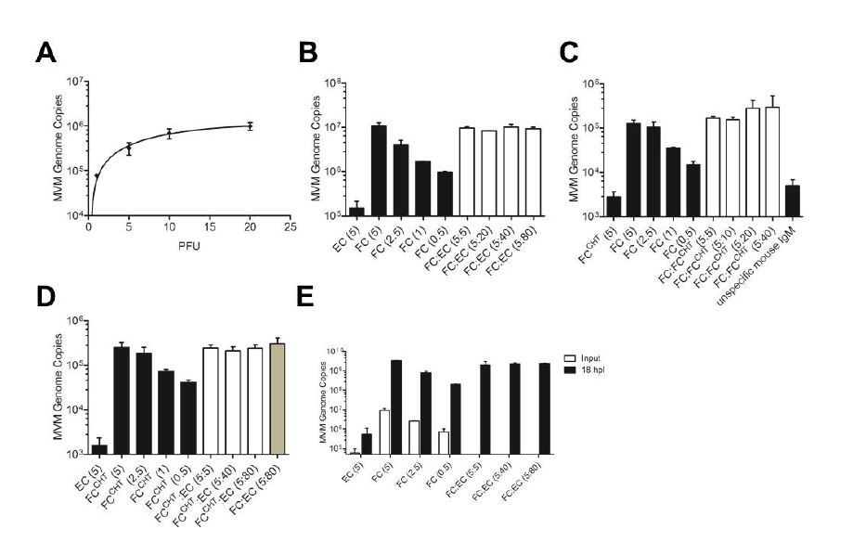

Slide 54
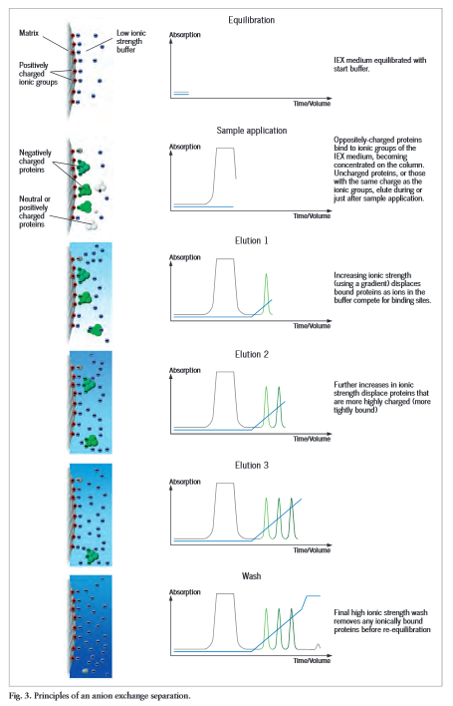

Slide 55
